Slide 1

Strings & Conditional Statements
A comprehensive exploration of text data manipulation, indexing mechanics, built-in string methods, control flow architectures, and algorithmic problem-solving.

Slide 2
Foundation of Knowledge
"Whoever travels a path in search of knowledge, Allah will make easy for him a path to Paradise."
"
"
— Prophet Muhammad ﷺ [Sahih Muslim 2699]
Every technical discipline, from string algorithms to machine learning pipelines, is elevated when approached with the sincere intention of beneficial knowledge and serving humanity.

Slide 3


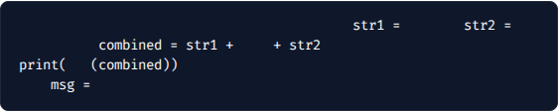
Strings: Creation & Concatenation
A string is a sequential data type representing Unicode characters. In Python, strings can be declared using single, double, or triple quotes.
# String declarations & escape characters
'Apna'
"College"
" "
# Concatenation
# Escape sequence for newline & tab
len
# Output: 12
"Hello\n\tWorld!"
Key Property: Python strings are immutable; assigning to individual character indices (e.g. str[0] = 'a') raises a TypeError.

Slide 4
String Indexing & Slicing Dynamics
Dual-Directional Indexing: Python supports zero-based positive indexing (0 to n-1 from left to right) and negative indexing (-1 down to -n from right to left).
Standard Slice Syntax str[start : end]: Extracts a substring from index start up to but excluding end. For instance, "ApnaCollege"[0:4] evaluates to "Apna".
Omitted Boundary Slices: Omitting the starting index str[:4] defaults to index 0, while omitting the end index str[4:] slices completely to len(str).
Negative Slicing Dynamics: Slicing with negative indices like str[-5:-1] yields characters from index -5 up to -2, critical for reverse parsing text sequences.

Slide 5

Essential Python String Functions
Function Syntax | Description & Mechanism | Example & Return Value
str.endswith(sub) | Returns True if the string terminates with the specified substring. | "i am coder".endswith("er") → True
str.capitalize() | Returns a copy with the 1st character capitalized without mutating original. | "coder".capitalize() → "Coder"
str.replace(old, new) | Substitutes all occurrences of old substring with new. | "hello".replace("l", "p") → "heppo"
str.find(sub) | Returns the 1st index of substring; returns -1 if not found. | "data science".find("sci") → 5
str.count(sub) | Computes the total frequency of occurrences of substring in string. | "banana".count("a") → 3

Slide 6



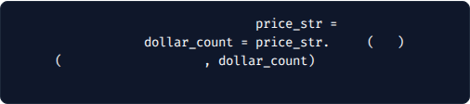
Hands-On Practice: String Programs
Program 1: Name Length Analyzer
Program 2: Character Occurrence Counter
Accept user's first name via input and display its exact character length:
Find the count and frequency of symbol '$' in a given financial string:
# Program 1: Input & Length
"Enter first name: "
input
# Program 2: Occurrence Counter
"Hi, $Iam the $ symbol $99.99"
# Sample Run
print
"Length of name is:"
len
count
"$"
# Output: Length of name is: 7
# Enter first name: Shradha
print
# Occurrences of $: 3
"Occurrences of $:"
# Sample Output

Slide 7
Conditional Statements
Enabling program decision-making through boolean evaluation, multi-branching trees, and precise 4-space indentation rules in Python.

Slide 8







Conditional Execution Constructs
if Statement
elif Ladder
else & Nesting
Evaluates a primary boolean condition. If True, executes the indented code block; otherwise skips it.
Allows chained testing of multiple mutually exclusive conditions in sequential order until one matches.
Default fallback branch when all above tests fail. Conditions can be nested within blocks for hierarchical logic.
elif
"Look & slow"
if
18
print
"Can vote"
"yellow"
print
else
print
"Stop / Default"

Slide 9


Grading Logic & Indentation
Student Grading Algorithm
90+
Demonstrates multi-branching conditional execution to map raw exam scores to academic performance tiers:
float
input
"Enter student marks: "
if
90
"A"
elif
Grade 'A' Threshold
80
and
90
"B"
elif
70
and
80
"C"
else
"D"
print
"Calculated Grade:"

Slide 10


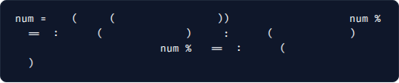
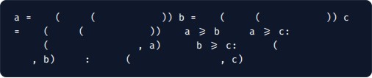
Algorithmic Practice Programs
Program 1: Even/Odd & Multiple Check
Program 2: Greatest of Three Numbers
Check parity and whether a number is divisible by 7 using the modulo % operator:
Determine the maximum among three numerical inputs using logical and operators:
int
input
"Enter number: "
# Parity Check
if
int
input
"Enter a: "
int
input
"Enter b: "
2
# Multiple of 7 Check
0
print
"Even number"
else
print
"Odd number"
int
input
"Enter c: "
if
and
"Multiple of 7"
if
7
0
print
print
"Largest is B:"
"Largest is A:"
elif
print
else
print
"Largest is C:"

Slide 11
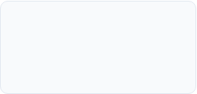
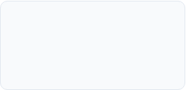
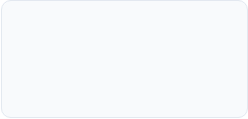

Data Science Pipeline Connection
1. Ingestion
3. Filtering
Raw text, CSV tokens, & user strings ingested as immutable Python strings.
Conditional branches (if/elif) filter anomalies and categorize records.
2. Slicing
4. Modeling
Substring extraction, prefix/suffix trimming via positive & negative slicing.
Structured string & boolean logic feed decision trees and NLP preprocessors.

Slide 12

Questions & Summary
Lecture 2 establishes the core primitives for all Natural Language Processing (NLP), data validation, and control structures in Python.
"اللَّهُمَّ إِنِّي أَسْأَلُكَ عِلْمًا نَافِعًا، وَرِزْقًا طَيِّبًا، وَعَمَلاً مُتَقَبَّلاً"
"O Allah, I ask You for beneficial knowledge, good provision, and acceptable deeds."
— Sunan Ibn Majah 925

Slide 13

Image Sources
https://engineering.freeagent.com/wp-content/uploads/2021/03/chris-ried-ieic5Tq8YMk-unsplash.jpg
Source: engineering.freeagent.com

